Slide 1



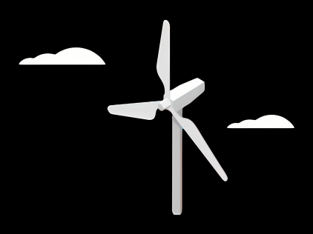
Rotor Hub And Pitch System
Group Members :
Dhruvin Kakdiya
Adharsh Pappinisseri Veedu
Muthu Thirunavukarasu
Syed Mohammed Sikandar
Week number : 02
Date: 07/10/2025
Supervisor: Prof. Peter Quell

Slide 2
Agenda
Comparison of Hub shape
Weighted evaluation of a pitch system
Selection of Inner or Outer ring Rotating
07/10/2025 Dhruvin kakdiya Rotor Hub and Pitch System/Optimus syria

Slide 3
Rotor Hub Shape Comparison
Category | Star hub | Sphere hub
Aerodynamic Efficiecy | 2 | 3
Structural simplicity | 3 | 2
Manufacturing ease | 3 | 1
Maintenance access | 3 | 1
Fatigue resistance | 2 | 3
Weight | 3 | 2
Cost | 3 | 1
Suitability(Onshore) | 3 | 1
Sum | 22 | 14
1 = Low preferable, 2 = Medium preferable, 3 = High preferable
07/10/2025 Dhruvin kakdiya Rotor Hub and Pitch System/Optimus syria

Slide 4
Weighted Evaluation of Pitch Control Systems
Criteria | Electrical Pitch | Hydraulic Pitch
Investment cost | 2 | 2
High torque | 3 | 1
Reliability | 3 | 3
Installation | 3 | 1
Operations at Hot climate | 3 | 1
Weight | 3 | 2
Service Friendliness | 3 | 2
Simple Design | 2 | 3
Sum | 22 | 15
1 = Low preferable, 2 = Medium preferable, 3 = High preferable
07/10/2025 Dhruvin kakdiya Rotor Hub and Pitch System/Optimus syria

Slide 5
Why Choose Electric over Hydraulic?
No Hydraulic oil→ no leaks or contamination risk in hot, dusty environment.
Handles high ambient temperatures and dust reliably with IP-rated enclosures.
07/10/2025 Dhruvin kakdiya Rotor Hub and Pitch System/Optimus syria

Slide 6
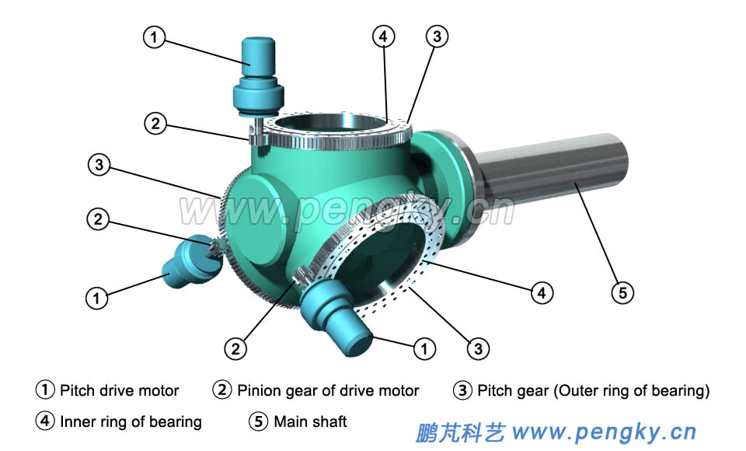
Outer-ring rotating
The blade is bolted to the outer ring and the inner ring is fixed to the hub
07/10/2025 Dhruvin kakdiya Rotor Hub and Pitch System/Optimus syria

Slide 7
Outer ring rotating
Pros
Cons
More compact hub/lighter hub design
Simpler lubrication routing to an inner stationary ring
Higher risk of ring cracking / blade detachment
requires extra protective covers / spinner / teeth covers
07/10/2025 Dhruvin kakdiya Rotor Hub and Pitch System/Optimus syria

Slide 8
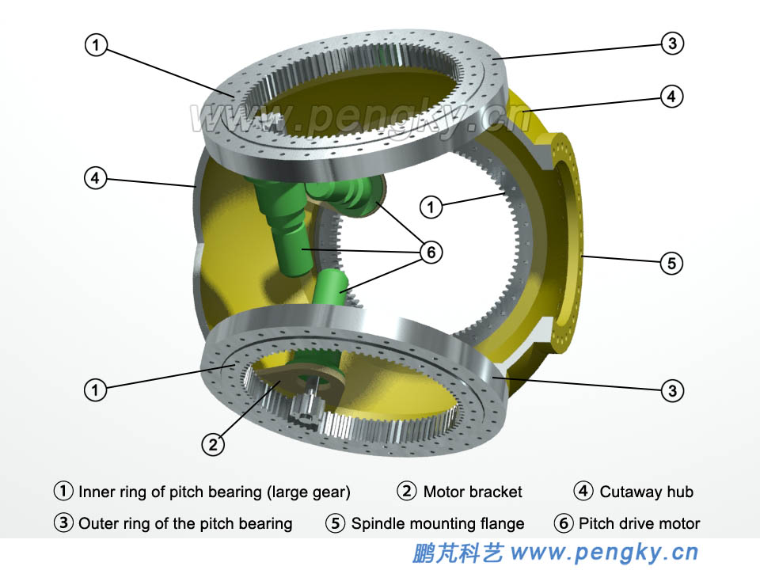
Inner-ring rotating
The blade is bolted to the inner ring and the outer ring is fixed to the hub
07/10/2025 Dhruvin kakdiya Rotor Hub and Pitch System/Optimus syria

Slide 9
Inner ring rotating
Pros
Cons
Safer from blade-detachment viewpoint
Pitch drives can be housed inside the hub ,simplifying environmental protection and maintenance access for the drives.
Can accommodate larger bearing diameter and more rolling elements
Hub may need to be larger to house internal drives and allow for the inner ring geometry
Internal packaging / integration is more complex (electrical routing, motor placement)
07/10/2025 Dhruvin kakdiya Rotor Hub and Pitch System/Optimus syria

Slide 10
Outer-ring and inner-ring rotating
Topic | Outer-ring rotating (blade bolted to outer ring) | Inner-ring rotating (blade bolted to inner ring)
Which ring rotates | Outer ring rotates | Inner ring rotates
Typical pitch drive location | external or on ring perimeter | inside hub
Bearing diameter & element count | Often limited by external packaging | Easier to realize larger pitch
Assembly & maintenance | Blade bolts accessed externally | Blade bolts accessible from inside hub
Common damage modes | Outer ring hoop stresses and through-cracking near bolt holes reported in field cases | Lower incidence outer-ring through-cracks because outer ring is fixed and less stressed
Suitability | Requires reinforced outer ring and protective housings; higher inspection/maintenance attention | Preferred — allows larger diameter bearings, internal drives, improved reliability for high moments typical of 5 MW
07/10/2025 Dhruvin kakdiya Rotor Hub and Pitch System/Optimus syria

